Slide 1

CSCI 680 Neural Networks For Computer Vision Project Demo AGE AND GENDER DETECTION
Abdul Moyeed Mohammed ( Z1912165 )
Omer Bin Ali Bajubair ( Z1905006 )

Slide 2
Overview
Executive Summary
Applications
Dataset
Earlier Approach
Proposed Approach
Network Architecture
Results
Live Demo
References

Slide 3
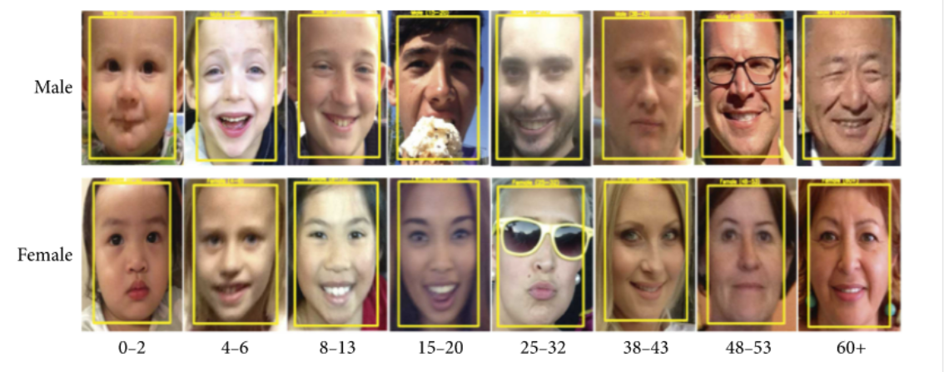
Executive Summary
To identify the gender and age range of a person from a image using CNN.
Notes:
Social media boom

Slide 4

APPLICATIONS
Electronic Customer Relationship Management

Slide 5
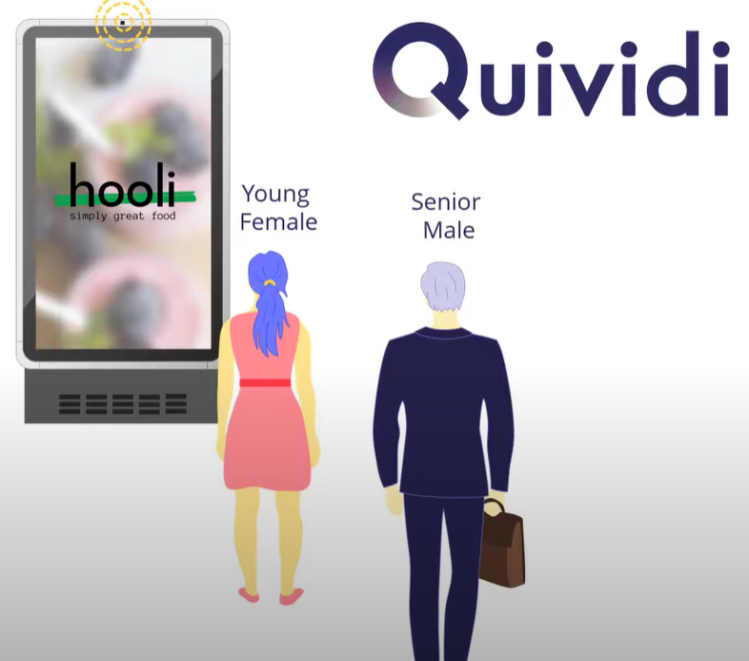
Notes:
7/11, examples

Slide 6
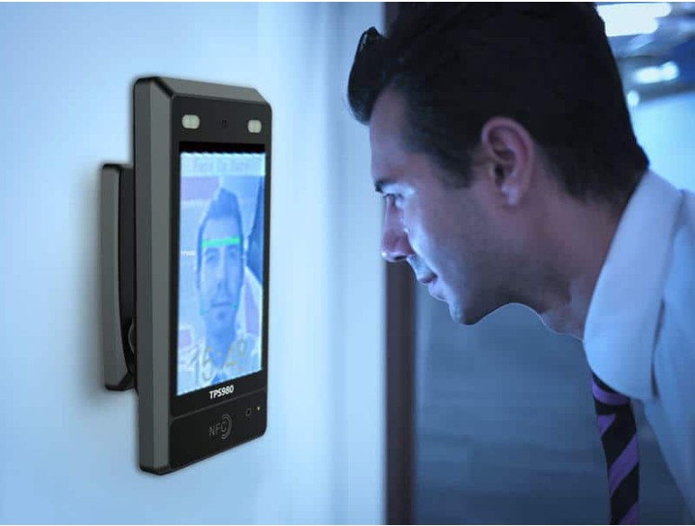
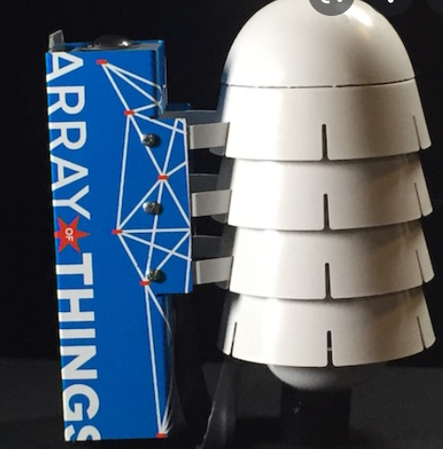

Access Control
Surveillance
Welcoming salutations
Human–computer interaction
Notes:
Amazon go , array of things

Slide 7
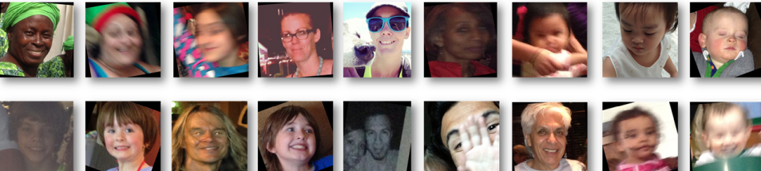
DATASET
ADIENCE DATASET
Total number of photos: 26,580
Size: Nearly 1 GB
Number of age groups / labels: 8 (0-2, 4-6, 8-13, 15-20, 25-32, 38-43, 48-53, 60+)
Notes:
Colab pro due to large image dataset size

Slide 8



Slide 9
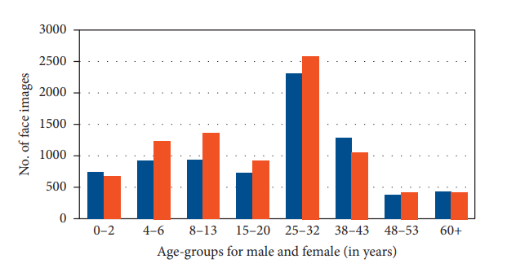
DATA VISUALIZATION
Notes:
Challenge of using audience

Slide 10
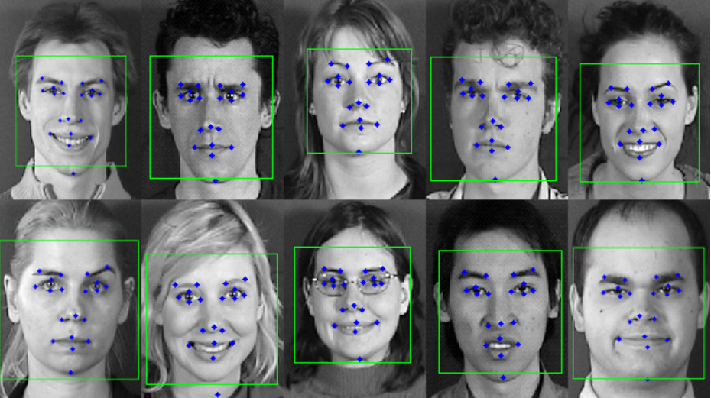
EARLIER APPROACH
Ratios among different dimensions of facial features

Slide 11
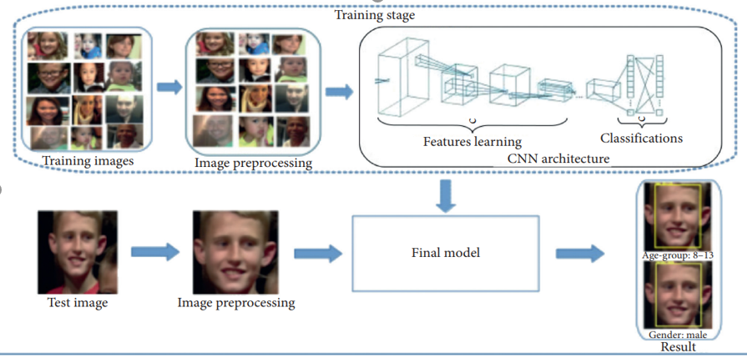
PROPOSED APPROACH

Slide 12


Slide 13
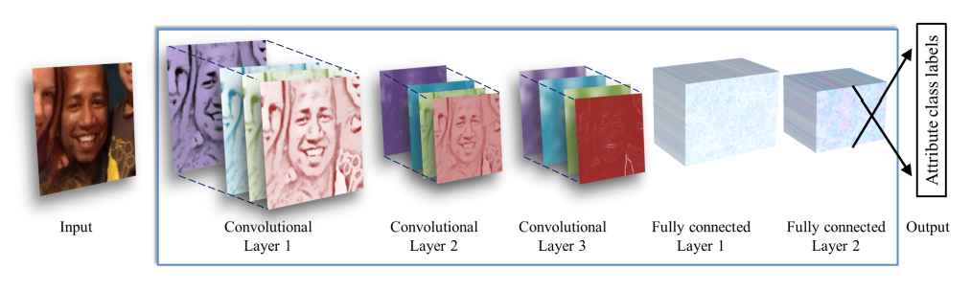
NETWORK ARCHITECTURE

Slide 14
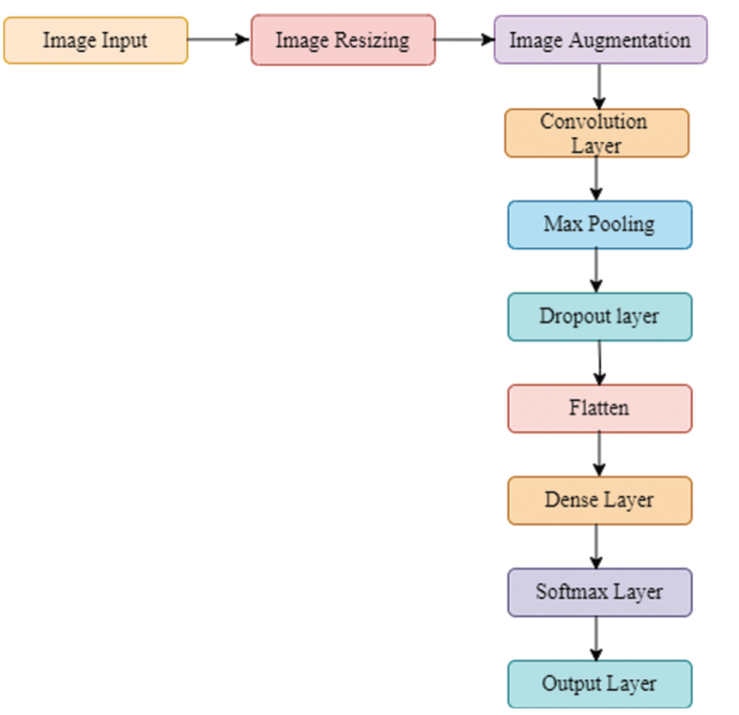
3 convolution layers each followed by activation function Relu
Pooling layer and dropout layer.
Data augmentation.
3 fully connected layers.

Slide 15
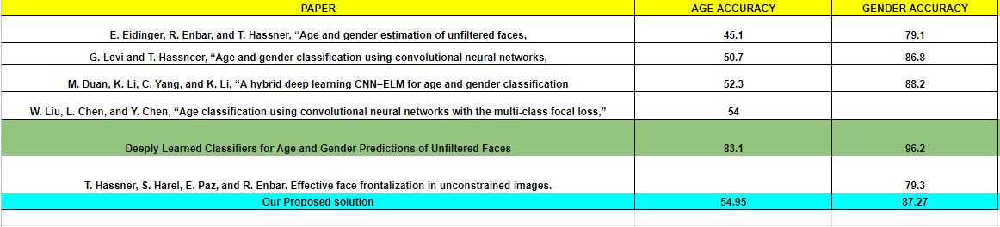
RESULTS

Slide 16
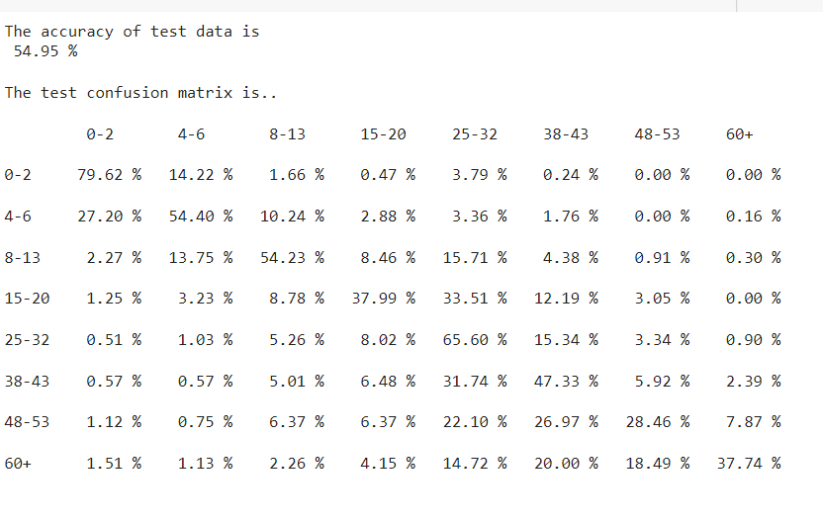
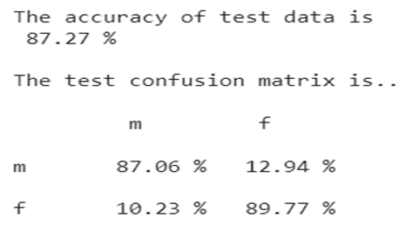
ACCURACY / CONFUSION MATRIX

Slide 17
CONCLUSION
We have achieved an accuracy of 87% on gender model and nearly 55% on age model
The state of the art for gender was 96.2 % and for age it was 83.1 % as discussed in Research Article: Deeply Learned Classifiers for Age and Gender Predictions of Unfiltered Faces.
But we have outperformed many of the other papers and have achieved a better model.

Slide 18
LIVE DEMO

Slide 19

CODE AVAILABLE ON GITHUB FOR REVIEW
LINK :
https://github.com/omer1997/NEURAL-NETWORK--GENDER-AGE-DETECTION

Slide 20
References
[1] G Levi and T Hassner, Age and Gender classification using convolutional neural networks, IEEE Conference on computer vision and pattern recognition workshops, 2015, pp
[2] G. Levi and T. Hassner, "Age and gender classification using convolutional neural networks," 2015 IEEE Conference on Computer Vision and Pattern Recognition Workshops (CVPRW), 2015, pp. 34-42
[3] Agbo-Ajala, Olatunbosun & Viriri, Serestina. (2020). Deeply Learned Classifiers for Age and Gender Predictions of Unfiltered Faces. The Scientific World Journal. 2020. 1-12.
[4] Mingxing Duan, Kenli Li, Canqun Yang, Keqin Li, "A hybrid deep learning CNN–ELM for age and gender classification", Neurocomputing,Volume 275,2018, Pages 448-461,ISSN 0925-2312.
[5] Grigory Antipov, Moez Baccouche, Sid-Ahmed Berrani, Jean-Luc Dugelay, “Effective training of convolutional neural networks for facebased gender and age prediction”, Pattern Recognition,Volume 72,2017,Pages 15-26,ISSN 0031-3203
[6] Jie Fang, Yuan Yuan, Xiaoqiang Lu, Yachuang Feng, "Multi-stage learning for gender and age prediction", Neurocomputing,2018
[7] Jia-Hong Lee, Yi-Ming Chan, Ting-Yen Chen, and Chu-Song Chen, "Joint Estimation of Age and Gender from Unconstrained Face Images using Lightweight Multi-task CNN for Mobile Applications”, arXiv,2018

Slide 21
[8] Ari Ekmekji,"Convolutional Neural Networks for Age and Gender Classification",2016
[9] S. H. Lee, S. Hosseini, H. J. Kwon, J. Moon, H. I. Koo and N. I. Cho, "Age and gender estimation using deep residual learning network," 2018 International Workshop on Advanced Image Technology (IWAIT),2018
[10] E. Eidinger, R. Enbar and T. Hassner, "Age and Gender Estimation of Unfiltered Faces," in IEEE Transactions on Information Forensics and Security, vol. 9, no. 12, pp. 2170-2179, Dec. 2014
[11] Dehghan, Afshin & Ortiz, Enrique & Shu, Guang & Masood, Zain. “DAGER: Deep Age, Gender and Emotion Recognition Using Convolutional Neural Network”.2017
[12] Alice Othmani, Abdul Rahman Taleb, Hazem Abdelkawy, Abdenour Hadid,"Age estimation from faces using deep learning: A comparative analysis",Computer Vision and Image Understanding,Volume 196,2020
[13] Greco, Antonio & Saggese, Alessia & Vento, Mario & Vigilante, Vincenzo,"A Convolutional Neural Network for Gender Recognition Optimizing the Accuracy/Speed Tradeoff ", IEEE ,2020
[14] Prototype for Gender and Age Prediction using PyTorch 2021 JETIR June 2021, Volume 8, Issue 6

Slide 22


